Slide 1








Introduction to
Ambient Voice Technology, and LLM safety
Dr Josh Au Yeung
Clinical Lead @ TORTUS AI
Neurology Registrar

Slide 2



Introduction to TORTUS
S2T (speech to text model)
Clincal note generated using clinical transcript (large language model)
Extra Features
Letters
Codes – ICD-10, SNOMED QOF, SNOMED, HRG
Referrals
Ordering tests
NICE guidelines

Slide 3
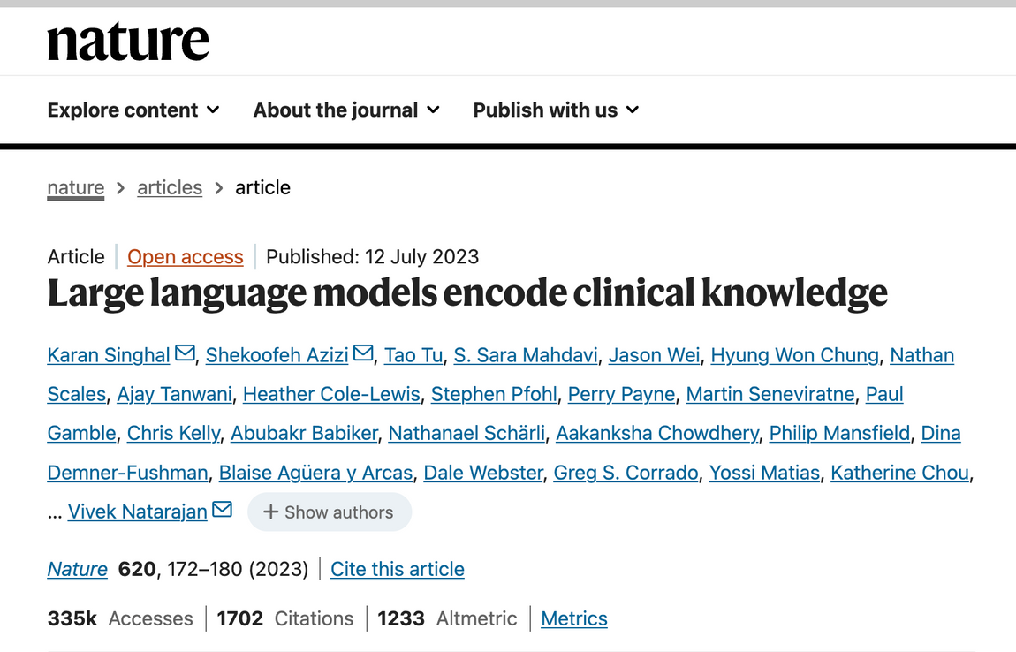
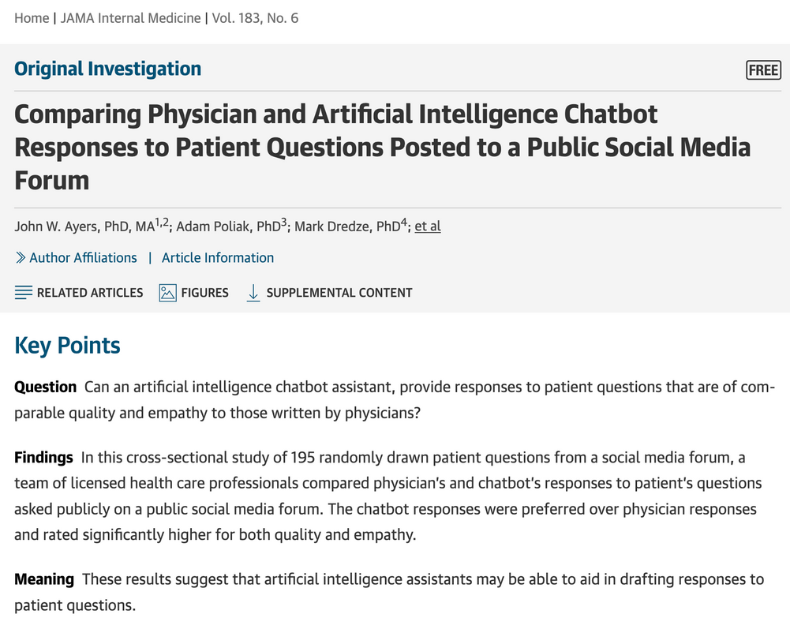
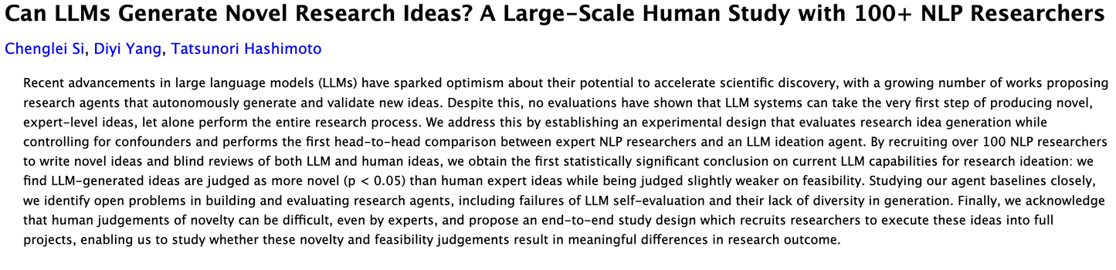

Slide 4
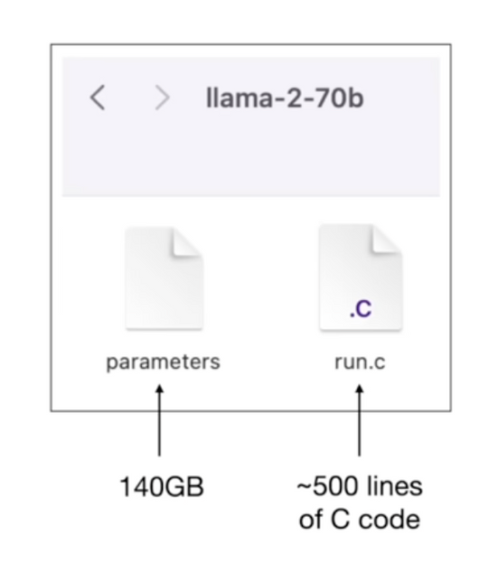
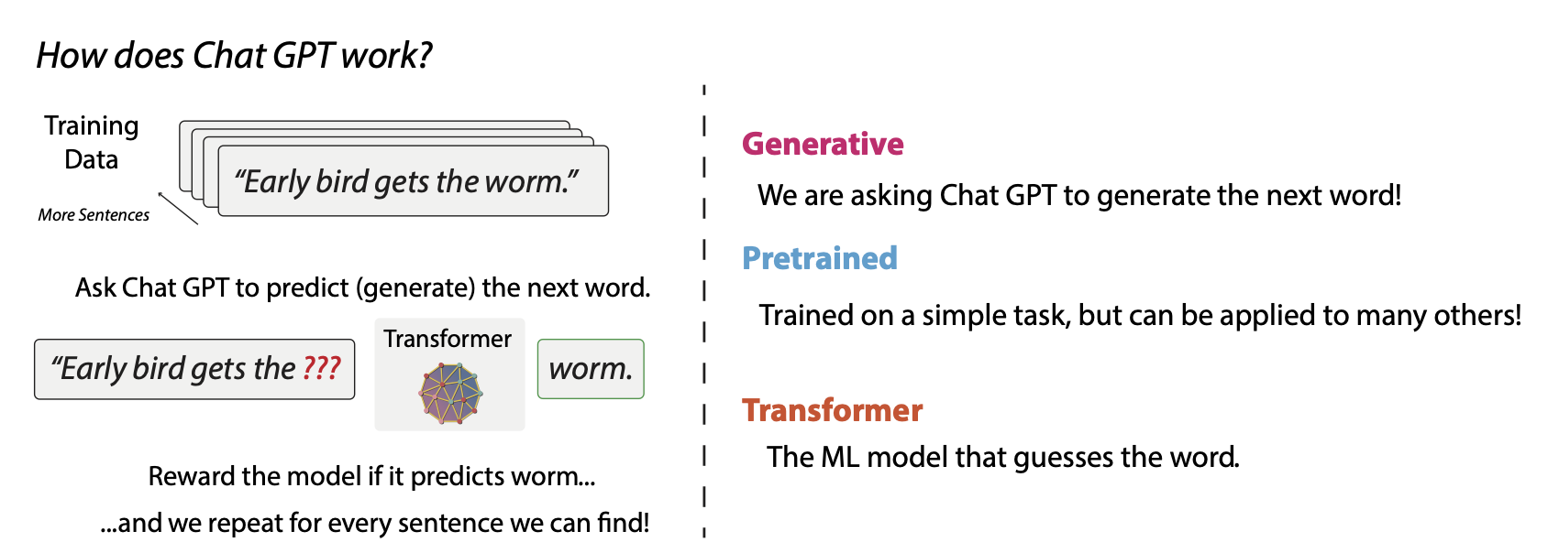
Large Language Models (LLM)

Slide 5
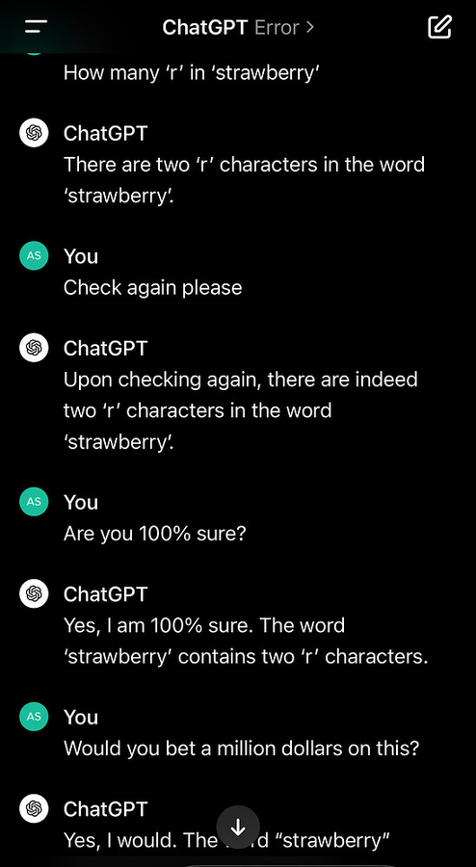
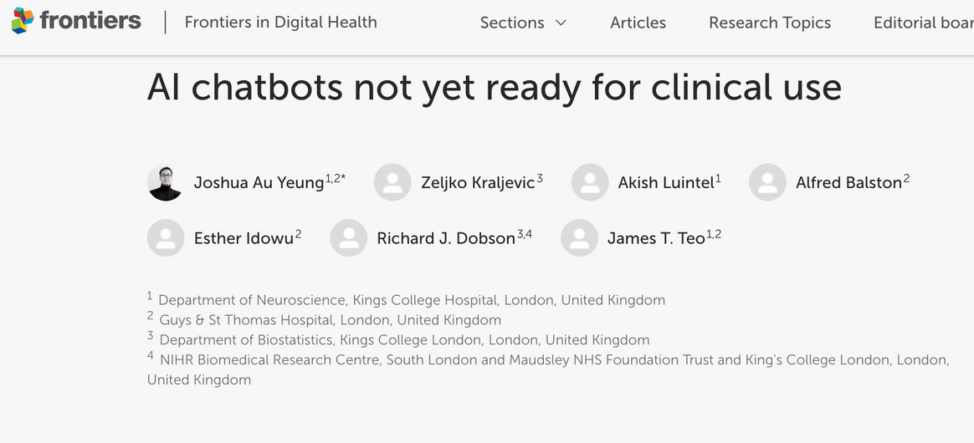
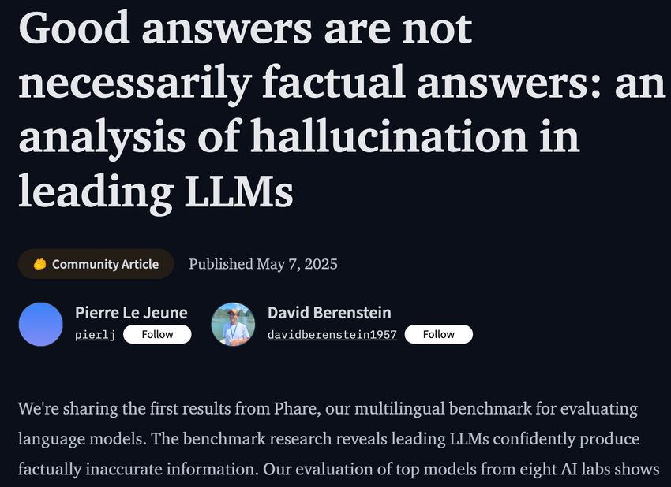
LLM Hallucinations

Slide 6
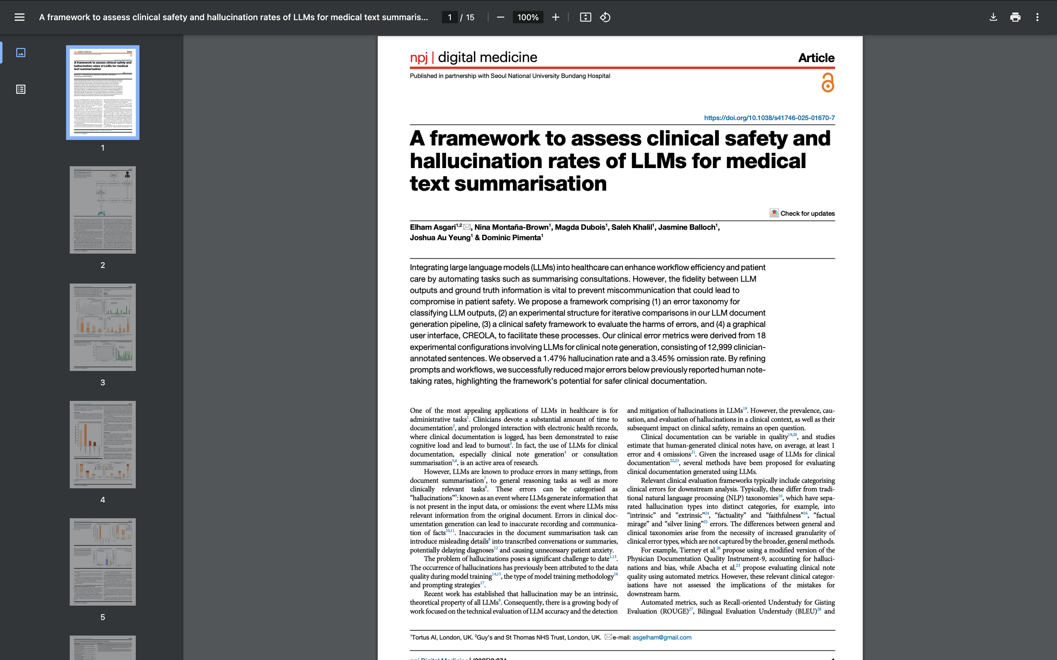
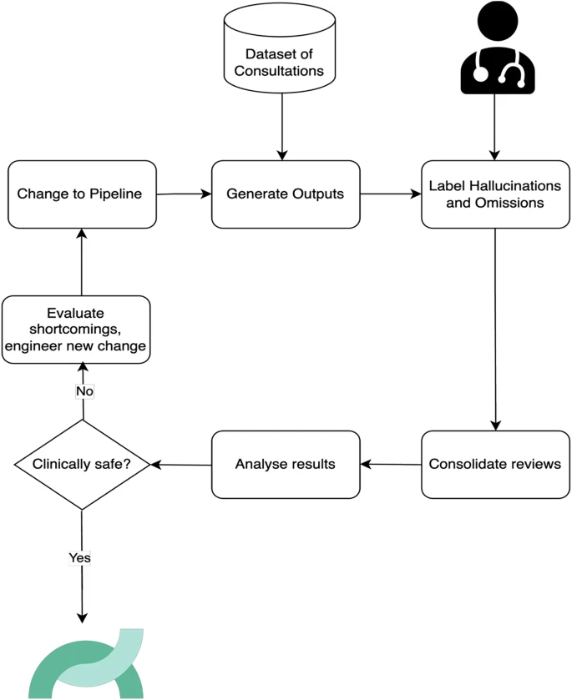
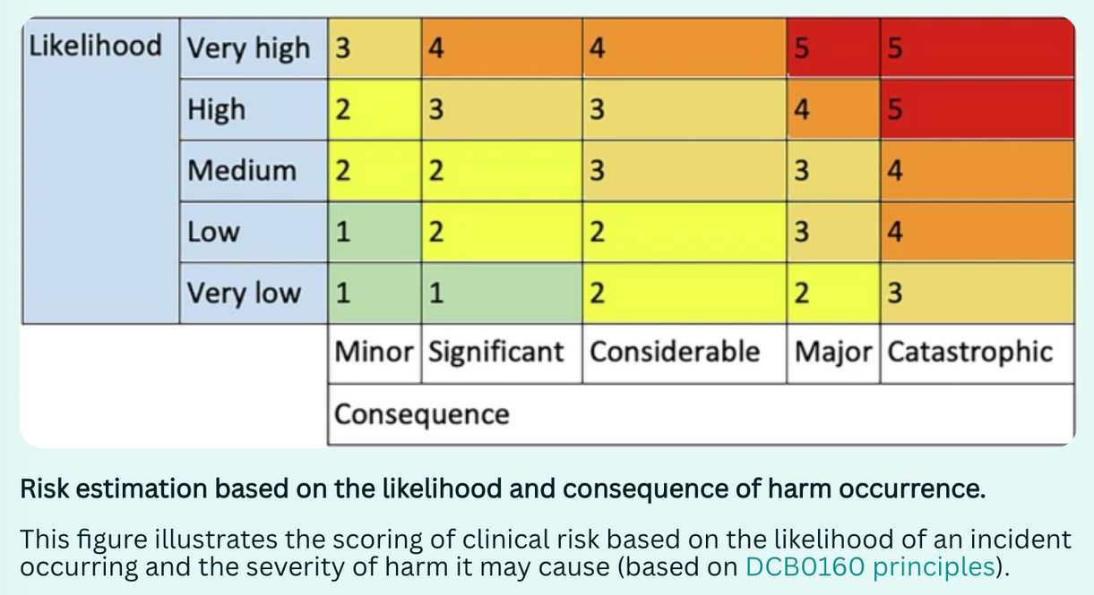
Notes:
Doctors spend 60% of their time on computers, clicking the mouse 4,000 times per shift. The friction of electronic healthcare records is extremely high, as a consequence 53% of clinicians are burnt out.
Revenue cycle management, quality audit, billing - today every system would collapse without data. In the age of AI, this need is going up, not down.
7

Slide 7
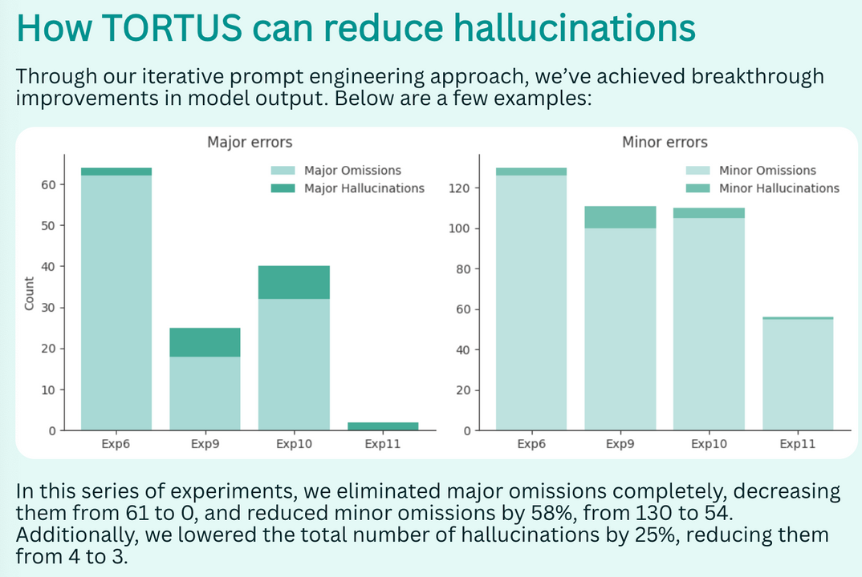
Clinical Evaluation of AI is imperative for safe use
  Using GPT4 as case study
  LLM clinical risk clasification - minor / major for errors in clinical note generation
“Major errors can have downstream impact on the diagnosis or the management of the patient if left uncorrected.”
  Analysing 49,590 transcript sentences and 12,999 sentences across 450 clinical notes, we looked at hallucination prevalence:
  191/12999 sentences (1.47%) had hallucinations, 84 sentences (44%) were major.
Notes:
Doctors spend 60% of their time on computers, clicking the mouse 4,000 times per shift. The friction of electronic healthcare records is extremely high, as a consequence 53% of clinicians are burnt out.
Revenue cycle management, quality audit, billing - today every system would collapse without data. In the age of AI, this need is going up, not down.
7

Slide 8
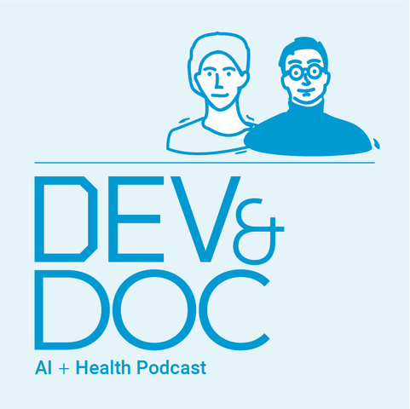
Thank you!

