Slide 1
Slide 1: Title slide
Implementing Variant Analysis Software
with AI features
North West GLH
University of Manchester NHS FT
24th June 2025
Ronnie Wright
Christopher Campbell
Elizabeth Sollars

Slide 2
What is AI?
Personal Disclaimer: I’m not quite sure
Ronnie Wright – Principal Clinical Scientist
Christopher Campbell – Principal Clinical Scientist
Elizabeth Sollars – Translational Bioinformatics Lead
Algorithmic logic Human Inference/Expertise
Artificial Intelligence

Slide 3
Slide 2: Project Context
Part of a wider transformation project:
Specialist Gene Panels
Analysis software:
AI
Lab technology:
Library preparation
Enrichment chemistry:
Custom Clinical ‘Exome’
Multiple teams
Multiple ‘specialist’ services
Notes:
Eager to ensure the assessment of AI was an assessment of the AI performance alone, as opposed to other influencing factors

Slide 4
Desired features of (any) prospective software
Maintain/improve existing sensitivity
Increased efficiency:
Positive cases
Negative cases
Specificity
Reduce variant volume?
User Experience
Reduce assessment time?
Reach decision/conclusion quickly and easily

Slide 5
Slide 3: Software Assessment & Validation
Variant detection
AI prioritization
AI variant classification (ACMG criteria)
Tested extensively on known positive cases
Range of variant types (including ‘challenging’ variants)
Pre-existing NWGLH variant classification database (‘training set’)
All positive variants of interest removed before testing (to avoid bias)
Real world scenarios (No HPO terms on referrals)

Slide 6
Cases/Variants of interest
Specialty | Total cases | Total variants of interest | Total CNVs | SNV | INDEL
Haematology | 52 | 68 | 10 | 51 | 7
Deafness | 49 | 74 | 11 | 45 | 18
Cardiac | 52 | 57 | 11 | 32 | 14
Metabolic | 13 | 21 | 0 | 13 | 8
Immunology | 31 | 35 | 0 | 27 | 8
Opthalmology | 30 | 42 | 0 | 30 | 12
FH | 30 | 34 | 0 | 25 | 9
Total | 257 | 331 | 32 | 223 | 76
Cases selected to include a representative range of variant types
CNVs limited to 3x specialties to minimize effort in PON creation

Slide 7
Software sensitivity
Sensitivity was broken down as for Emedgene (v2.31) as follows
Sensitivity of promotion of variant of interest to AI categories
Sensitivity of detection of variant of interest in total unfiltered variant set
Sensitivity Measure | Total variants of interest | Total variants of interest detected | Total variants of interest undetected | %age sensitivity estimate (+/-95% CI)
A | 331 | 294 | 37 | 88.8% (84.9-92.0)
B | 331 | 321 | 10 | 97.0% (94.5-98.5)
AI sensitivity: 91.6% (294/321)

Slide 8
Slide 4: Implementation of Presets
Designed presets to capture the ~10% variants not promoted by AI
Presets enable continued analysis when AI negative
Performance: Higher sensitivity and specificity than previous software, even with presets enabled
Sensitivity of promotion of variant of interest to AI categories and pre-sets
Sensitivity of detection of variant of interest in total unfiltered variant set
Sensitivity Measure | Total variants of interest | Total variants of interest detected | Total variants of interest undetected | %age sensitivity estimate (+/-95% CI)
A | 331 | 312 | 19 | 94.3% (91.2-96.5)
B | 331 | 321 | 10 | 97.0% (94.5-98.5)
AI plus generic preset performance: 97.2% (312/321)

Slide 9
Parallel Analysis study
100 cases across 2 specialties
Clinically reported variants
Category | Deafness | Cardiac | Total | % of total
AI | 30 | 10 | 40 | 93%
Presets | 2 | 1 | 3 | 7%
Total no. variants prioritized
Specialty | Total no. variants AI | Total No. variants existing software | %AI vs existing software | Total No. variants AI & presets
Deafness | 319 | 659 | 48.4% | 738
Cardiac | 84 | 317 | 26.5% | 210
Total | 403 | 976 | 41.3% | 948
Specificity is dependent on:
Accepted levels of sensitivity
Approach to ‘rescue’ presets
False positive variant detection

Slide 10
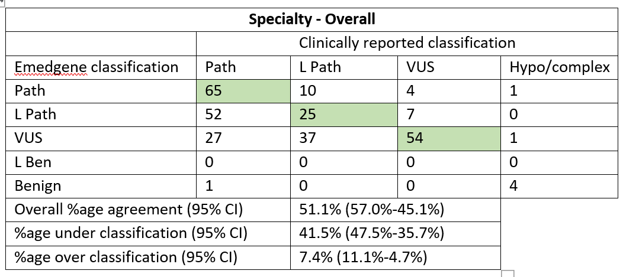
AI classification: small variants
288 clinically reported SNV/Indel variants across 7 RD specialties
Tendency of AI to under-classify
AI does not automate inclusion of PS4, PP4, BS1, BS2 or BP5 classifiers
Calculation excludes 6 hypomorphic/complex variants in dataset

Slide 11
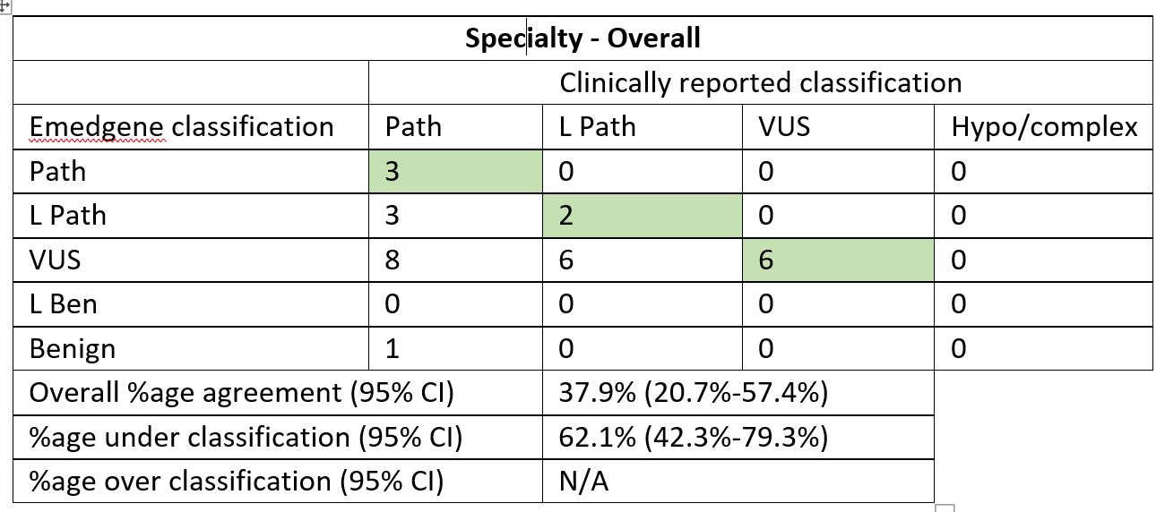
AI classification: CNV
29 clinically reported CNVs across 3 RD specialties
Consistent under-classification of AI relative to SNVs
Likely due to use of ACMG technical standards framework for CNVs (Riggs et al., 2020)

Slide 12
Slide 5: Attractive Features of Software
Exceptional AI performance
AI continually improving via internal curated data
More sophisticated presets using Boolean logic
Example: Retain synonymous variants only if splice effect predicted
Separation of analysis & curation

Slide 13
Slide 6: Separation of Analysis & Curation
Patient centric
Variant/ observation centric
DGV
Clinical Variant Arc
GnomAD
HGMD
ClinVar
Evidence/ Classificationcentric

Slide 14
Emedgene
Patient centric
Evidence/ Classificationcentric
Variant/ observation centric
Curate
Analyze
De-couples patient analysis ("Analyze") from variant classification ("Curate")
Avoids conflicts caused by multiple classification records across patients
Single, authoritative classification record with history — improves accuracy

Slide 15
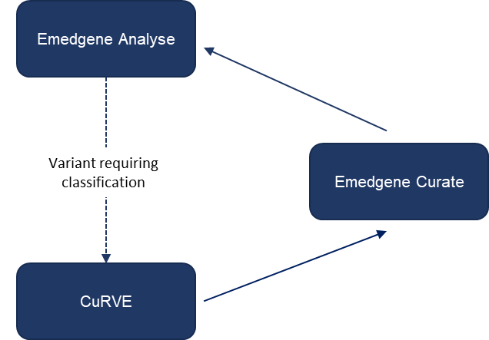
Slide 7: Importance of Data Curation
AI only as good as curated data from which it learns
What and how to record in "Curate" is critical
Integration with local CurVE system:
Holding and approval stage for curation
Single coordinated source of truth for AI

Slide 16
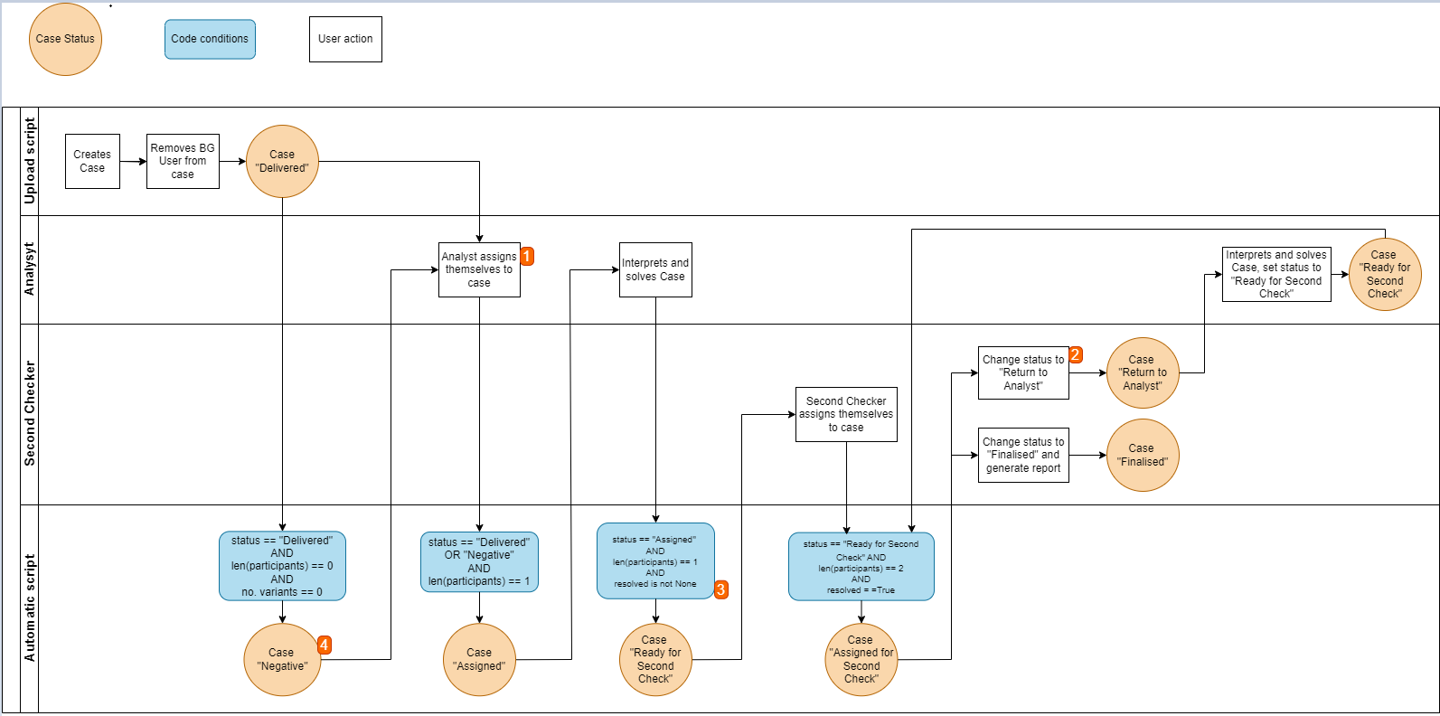
Slide 8: Semi-Automation & Workflow Stratification
Integration of local scripts for case labelling:
Negative label if zero variants found
Positive label if e.g. curated P/LP dominant variant present
Stratifies cases for assignment:
Obvious negative
Obvious positive
Scientific review required

Slide 17
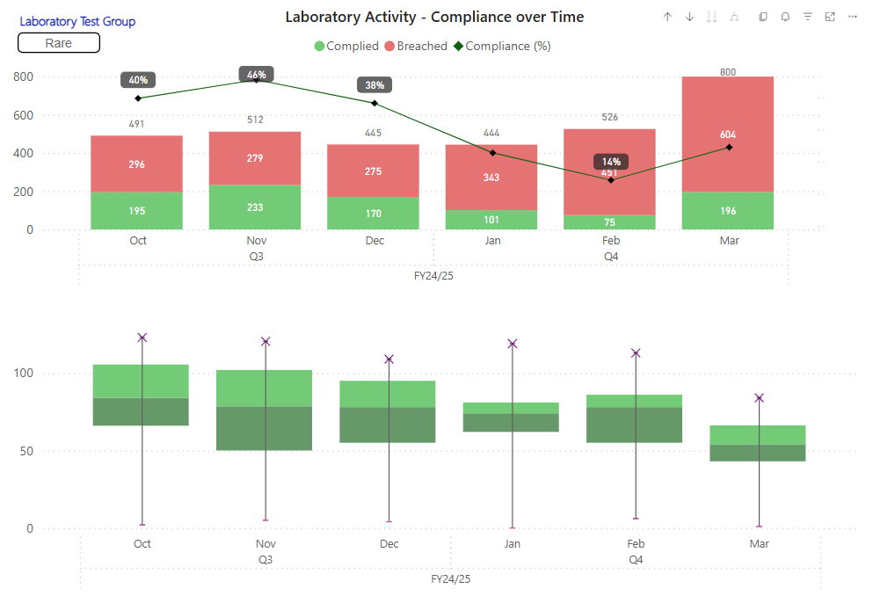
Slide 9: Summary & Impact
Thoughtful integration enhanced sensitivity and specificity
AI performance and curated data synergy key to success
Streamlined workflows with clear roles and data transparency
Positioned well for future AI improvements

Slide 18
Acknowledgements
NWGLH
Christopher Campbell
Elizabeth Sollars
Andrew Wallace
David Gokhale
Stephanie Barton
Simon Ramsden
Emma McCarthy
Diane Cairns
Stuart Gillies
Fern Johnson
Sam Rowlston
Rob McMahon
Jessica Howes
Illumina
Claire Logan
Tom Payne
Amy Priestman
Daniel Forth
Sam Hamlett

Slide 19
Slide 10: Q&A
Thank you!
Questions?

